Slide 1
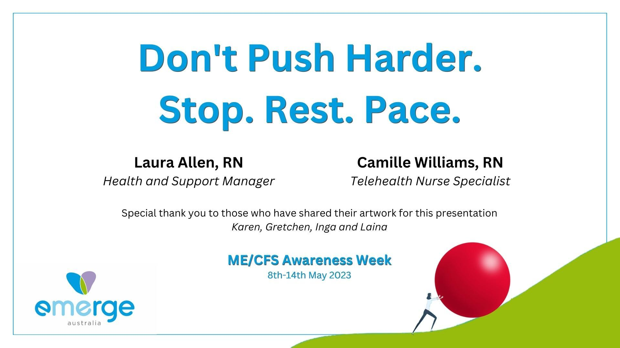

Slide 2





Don't Push harder. Stop. Rest Pace.
Stop.​
Activity before you experience symptoms, or as soon as you notice an increase in symptoms.​
​
Rest.​
Take regular rest breaks throughout the day​
​
Pace.​
This involves breaking activities up with periods of rest, to allow our battery to charge. Everyone will be different in how much we can do and how much rest we need.

Slide 3

Don't Push harder. It might be PEM!
PEM can be triggered by physical and/or cognitive activity^{1,2}, as well as emotional, physical traumas, orthostatic and sensory stressors^{3,4}.
PEM is the exacerbation of symptoms when patients exceed their energy threshold⁵
The increase in symptoms, and reduction in ability, may be immediate or delayed by up to 72 hours⁶.
The duration of PEM is unpredictable and can last from hours to days to weeks⁷
PEM and fatigue are different
Emerge Australia’s community
Activity past a certain threshold will decrease function and increase symptoms severity

Slide 4
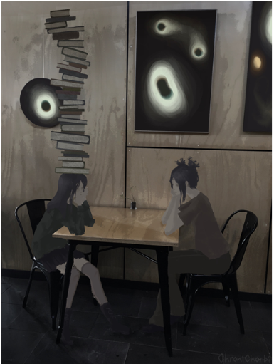
Don't push harder.
If you have PEM symptoms
Reduced stamina​
Physical fatigue + mentally wired​
Cognitive exhaustion​
Problems thinking​
Unrefreshed sleep
Insomnia​
Muscle pain​
Muscle weakness​
Dizziness​
Flu like symptoms​
Laina Alexander, year 12 artworks
@chronichorbi.

Slide 5
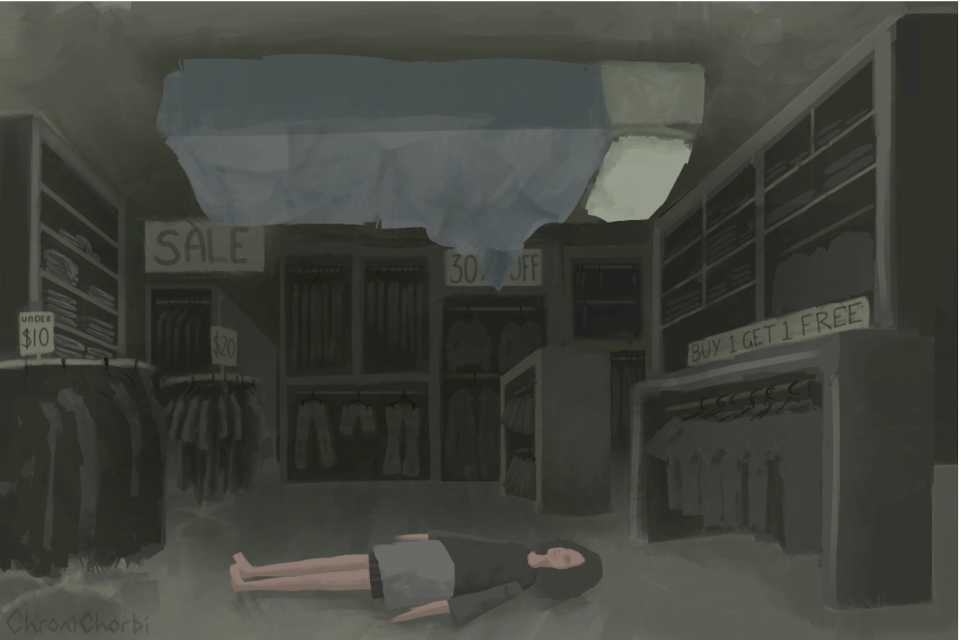
PEM, the community voice 2022
Like a brick wall falling on me and not being able to move or think or talk
Like 1000 piranhas attacking me from the inside ​
A full drain of energy, pain, weakness​
Going into hibernation​
Completely debilitated​
Like walking through sand​
Legs burning with lactic acid
Exhausticated
Not able to think straight at all​
My body is on fire ​
Flat like a ribbon ​
Completely debilitated ​
Killed my power switch​
Feel like I’ve been hit by a truck
Laina Alexander, year 12 artworks
​@chronichorbi.
Crash, crashed, wrecked, flare up, payback, no more spoons,
comatose state, no more spoons, flat like a ribbon

Slide 6

Don't push harder. STOP.
The community voice awareness week 2022
When in doubt, lie down!! ​
Learn to stop... why sit when you can stand... why stand when you can lie down... ​
STOP, REST.... ​
Don’t push through ​
Don’t lose hope ​
Give yourself a break and learn to listen to your body. What’s your body trying to tell you? ​
Stop pushing ​
Believe in yourself and your understanding of your own body ​
Learn what your PEM symptoms are so you know your warning signs to stop
A place I'd like to rest by Karen Le Roux
Learning to stop, can be more difficult than it seems.
Stop activities before you experience symptoms, or as soon as you notice an increase in symptoms.

Slide 7
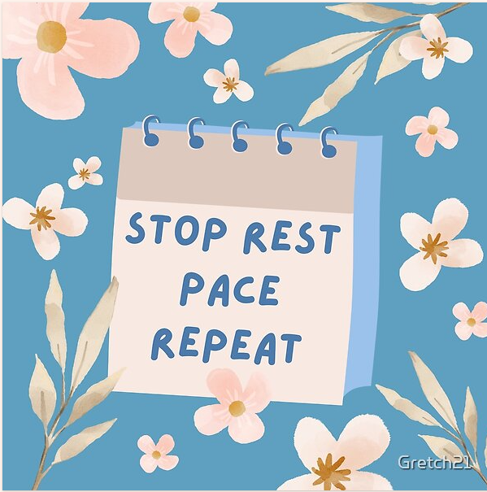
Don't push harder. REST.
Sleep involves hormonal changes and when a person is sleeping, they are unaware of their surroundings. ​
​
Rest is when the mind is consciously relaxed, but the person is aware of what is happening around them. ​
​
​Complete rest involves minimal activity. This means no stimulation, like TV, social media, reading or listening to music​
​
For some, this is very restrictive and may need to be adjusted to meet the needs of the individual.
Gretchen Netterfield
The aim is to reduce activity to a minimum, allowing the body to recharge

Slide 8

Don't push harder.
Relax the mind and body to recharge
If complete rest is causing discomfort or distress, finding other ways to reduce activity is important.
  find a quiet activity to do, such as drawing, building Lego or listening to a story ​
  do an audio meditation or listen to soft music ​
  sit in nature ​
  lie with legs elevated and a mask covering eyes or a soft fan blowing on the face
Gretchen Netterfield
If rest was an Olympic sport, go for gold
Community voice awareness week 2022

Slide 9

Don’t push harder. Explore options to rest
Some people find certain types of external stimulation can help them relax and quiet their mind. Try and explore using a weighted blanket, lying in a hammock, or using white/pink noise.
“Megan has moderate ME/CFS, and she also has ADHD. She finds resting difficult and feels agitated when she tries to lie down with no external sounds or activity. She has explored different options and has found swinging gently in a hammock or using a weighted blanket help her rest. Sometimes listening to an audio meditation or enjoyable podcast with positive content is also helpful. Sketching quietly also puts her into a restful state”.
Gretchen Netterfield

Slide 10
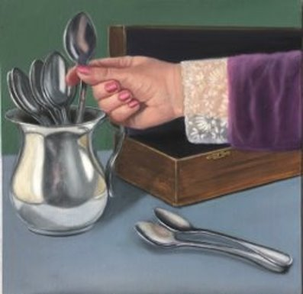
Don’t push harder. Pace.
The aim of pacing is to leave some ‘energy in your battery’ at the end of the activity. ​
​
Pacing, like any other skill, must be practiced. It becomes easier over time.​
An increase in symptoms after adding additional activity may indicate that you have exceeded your energy limits and you should reduce to the previous activity level.​
​
If possible, you should not attempt more activity until PEM has reduced.
Karen Le Roux

Slide 11

Don’t push harder. Pace.
Identify areas where energy expenditure could be reduced, Consider:
    how important is the activity?​
    can the activity be completed less often? ​
    can the energy used to complete the activity be reduced? ​
    can someone else support /help with the activity?
Inga Topolnicki - An Existence Project

Slide 12

Thank you
Laura Allen, RN​
Health Support Manager
Camille Williams, RN​
Telehealth Nurse Specialist
Notes:
If your patients need further support to pace, or help navigating the healthcare system we are here to help. Patients can self-refer by going to the website and booking an appointment or you can refer on their behalf. You can also call us if you have any questions and one of our nurses will get back to you.

Slide 13
References
1. van Campen, C. M. C., Rowe, P. C. & Visser, F. C. Orthostatic symptoms and reductions in cerebral blood flow in long-haul covid-19 patients: Similarities with myalgic encephalomyelitis/chronic fatigue syndrome. Medicina (Lithuania) 58, (2022).
2. van Campen, C. (Linda) M. C., Rowe, P. C. & Visser, F. C. Cerebral blood flow remains reduced after tilt testing
3. Light, A. R. et al. Gene expression alterations at baseline and following moderate exercise in patients with Chronic Fatigue Syndrome and Fibromyalgia Syndrome. J Intern Med 271, (2012).
4. van Oosterwijck, J. et al. Pain inhibition and postexertional malaise in myalgic encephalomyelitis/ chronic fatigue syndrome: An experimental study. J Intern Med 268, (2010).
5. Nijs, J. et al. Altered immune response to exercise in patients with chronic fatigue syndrome/myalgic encephalomyelitis: A systematic literature review. Exerc Immunol Rev 20, (2014). ​
6. Skjørten, I. et al. Cardiopulmonary exercise capacity and limitations 3 months after COVID-19 hospitalisation. European Respiratory Journal 58, (2021). ​
7. VanNess, J. M., Snell, C. R. & Stevens, S. R. Diminished cardiopulmonary capacity during post-exertional malaise.
J Chronic Fatigue Syndr 14, (2008). ​
Notes:
If your patients need further support to pace, or help navigating the healthcare system we are here to help. Patients can self-refer by going to the website and booking an appointment or you can refer on their behalf. You can also call us if you have any questions and one of our nurses will get back to you.

